Slide 1
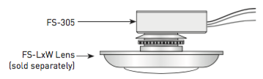
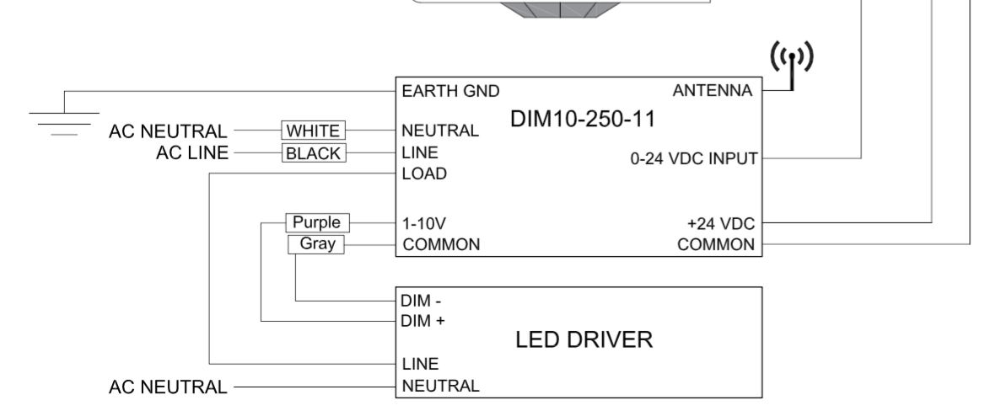
DIM10-250-11 wiring for a
WattStopper FS-305
Common - Black
+24V - Red
Control - Blue
Black
Blue
Red

